Slide 1
Introduction : personal development challenges
TENNIS AT HOME

Slide 2
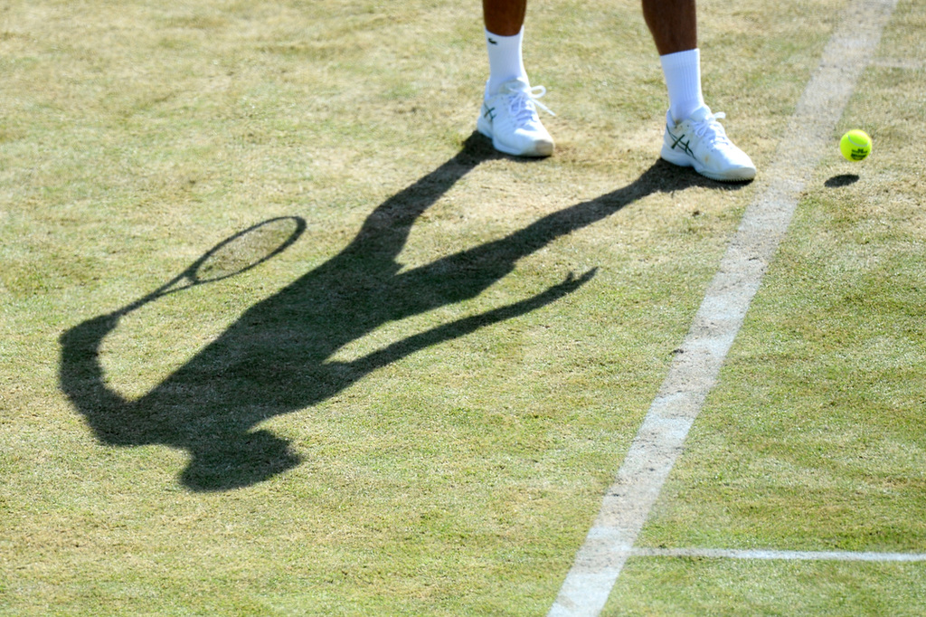

WHAT DO YOU KNOW ABOUT THE GAME OF TENNIS?
What do you already know about the game of tennis?
Do you know how to play tennis, and how to score?
Did you know that you can develop and use some of the qualities that tennis players have in your everyday life?
A quality is a characteristic; the kind of person someone is.
Click on the play button in the middle of the screen to watch the first film of people playing tennis!

Slide 3
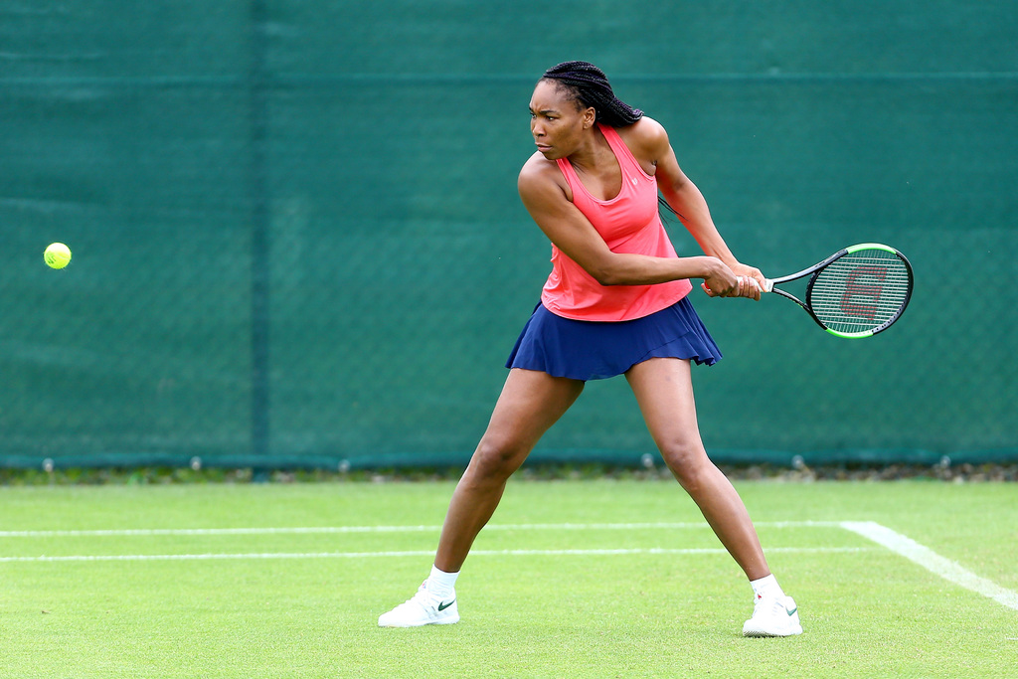
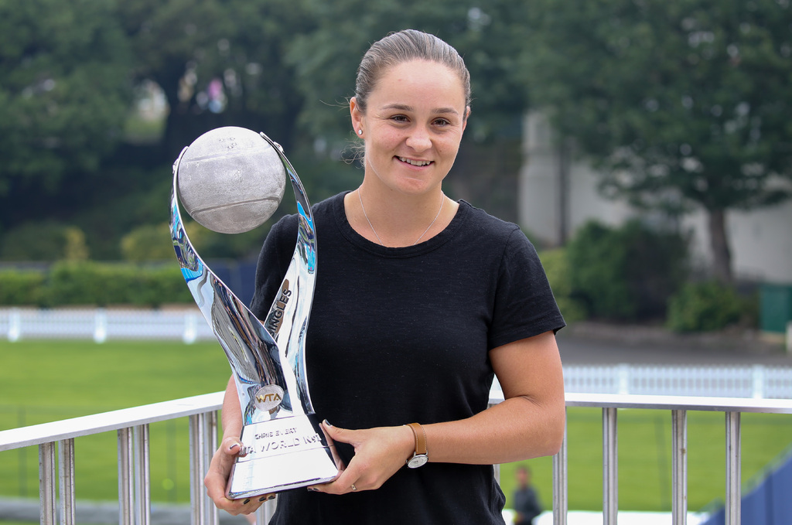
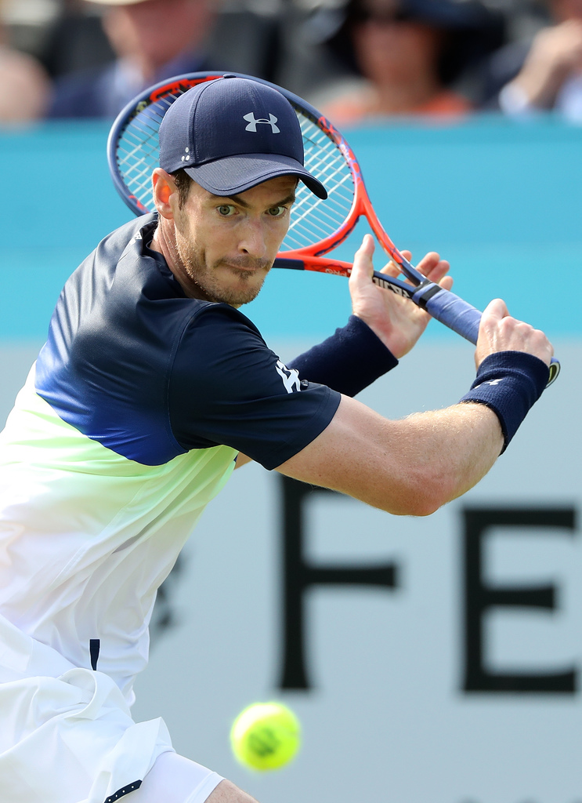

TENNIS HEROES
People who love watching tennis often have their own tennis heroes. You might have heard of some of them, or have tennis heroes yourself. There are lots of well-known and popular tennis players; here are three of them:
Turn to the next slide to find out more about these three players…

Slide 4
TENNIS HEROES
Venus Williams plays tennis for the USA. She holds 49 singles titles, including five at Wimbledon and two at the US Open. With her sister Serena she holds 22 doubles titles and three Olympic gold medals.
Ashleigh Barty plays tennis for Australia. She is 23 years old and is currently ranked number one in the world. She has won eight singles titles (including the French Open in 2019) and ten doubles titles so far in her career.
Andy Murray is the Great Britain’s best known tennis player. He has won 46 singles titles, including Wimbledon in 2013 / 2016, gold at the London Olympics in 2012 and three doubles titles. His winning match at Wimbledon in 2013 was watched by 17.3 million people!

Slide 5
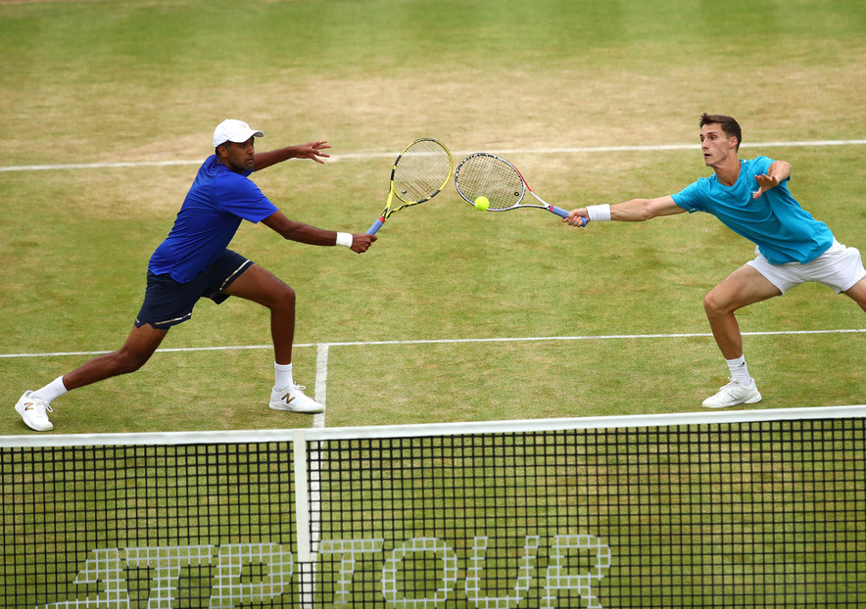
PHYSICAL SKILLS AND QUALITIES
What do you think it takes to play tennis well?
Which skills and qualities do tennis players need?
A quality is a characteristic, or the kind of person someone is.
Tennis players need to be fit to play well, but here are some other physical qualities that they need: strength, power, flexibility, balance, coordination, control, quick reactions, speed

Slide 6
TENNIS HEROES
Tennis players also need other types of qualities, not just physical ones. These are called character qualities, because they describe the type of people the tennis players are.
It’s not just tennis players who have these character qualities though; even if you have never played tennis you have, or can develop, these qualities too, and they can help you in everyday life.
There are different character qualities which tennis players need, but here are five key qualities:
RESILIENCE – PERSEVERANCE - MOTIVATION - PASSION - RESPECT
Watch the film on the next slide, which shows people playing and watching tennis, and demonstrating the different character qualities.

Slide 7
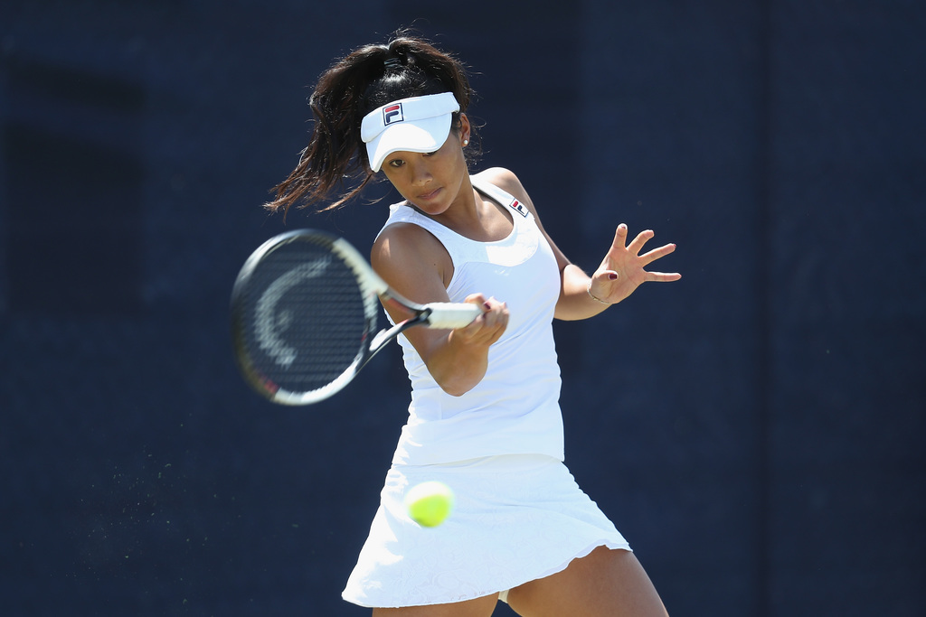
CHARACTER QUALITIES

Slide 8
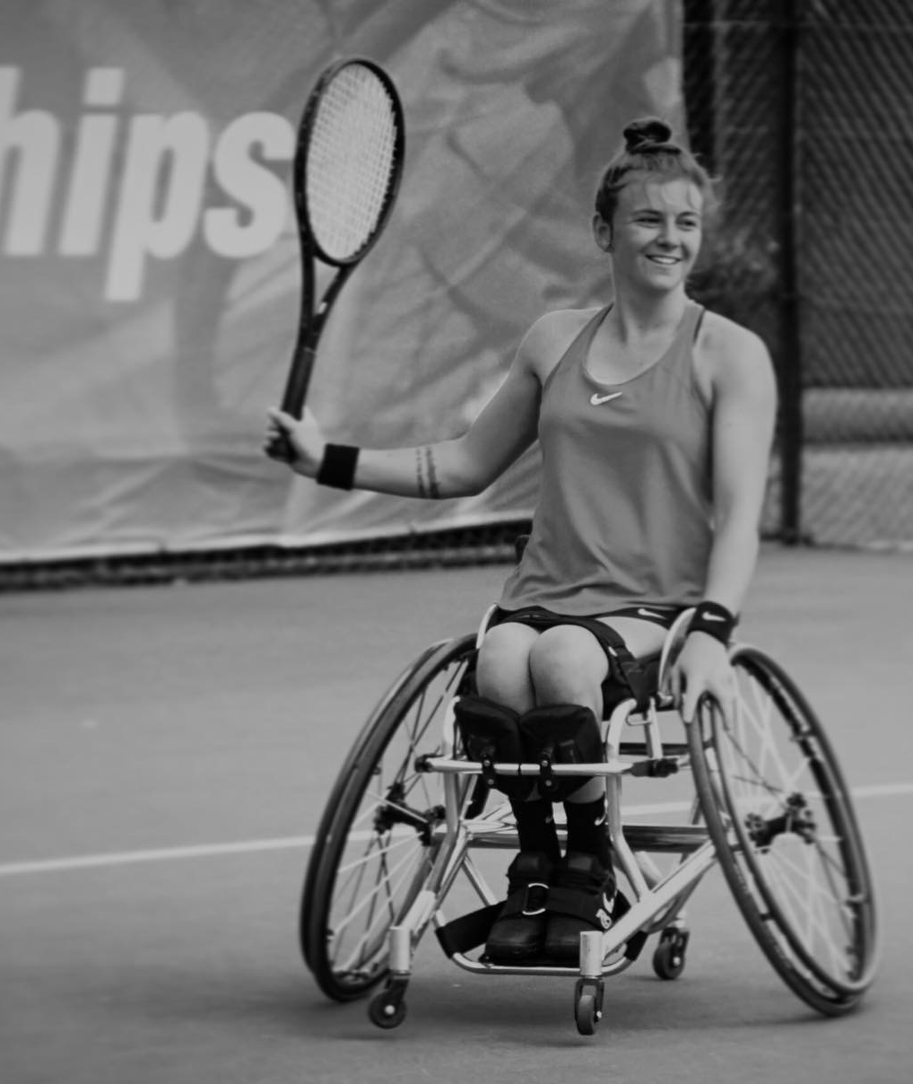
CHARACTER QUALITIES
RESILIENCE
Resilience means when you can ‘bounce back’ and get through something which has been difficult, or made you unhappy.
“
I am not what happened to me,
I am what I choose
to become.
Lauren Jones
When Lauren was 13 she fell out of a tree and broke her back, leaving her paralysed and in a wheelchair. She is currently on the LTA’s GB Wheelchair Tennis World Class Performance Programme.
“

Slide 9
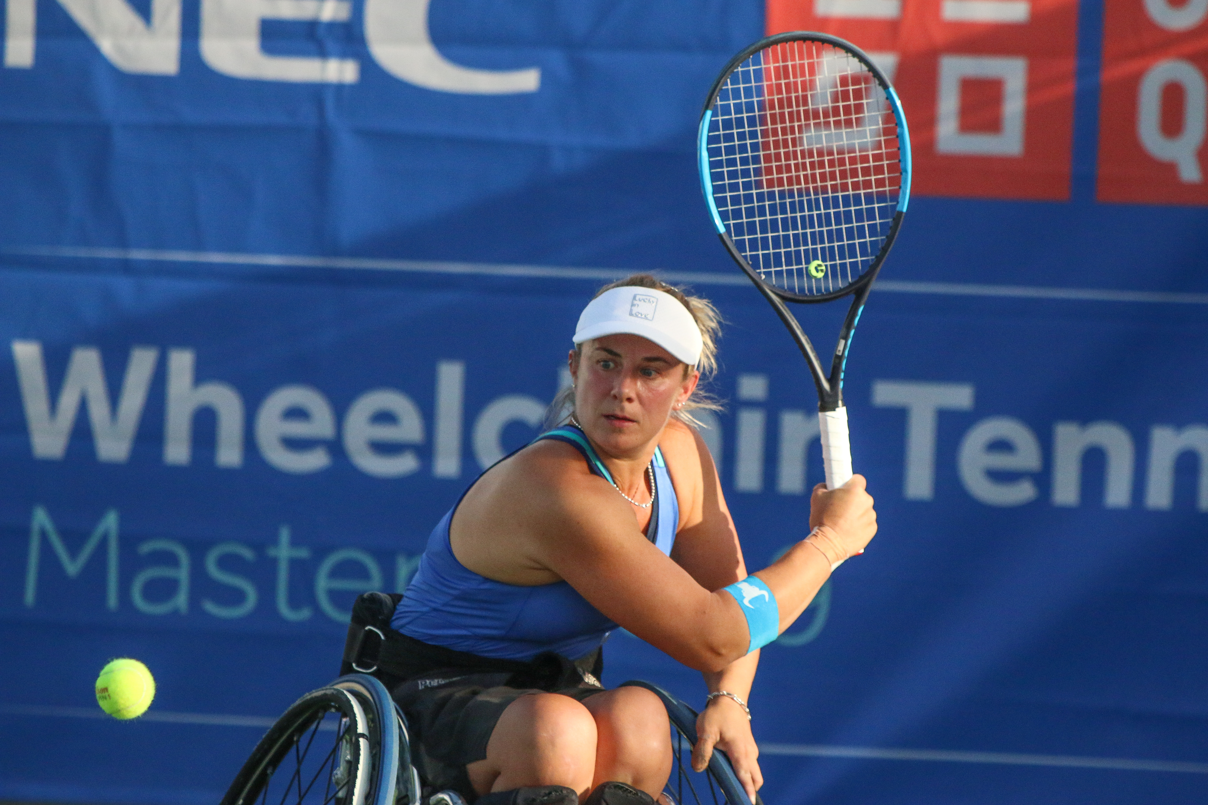
CHARACTER QUALITIES
PERSEVERANCE
Perseverence is when you keep on trying at something and don’t give up.
“
Set yourself goals and when you reach them, set more.
Lucy Shuker
“
Lucy is a double Paralympic medallist, a former World doubles champion, four time Wimbledon doubles finalist, World Team Cup medallist and National Champion.

Slide 10
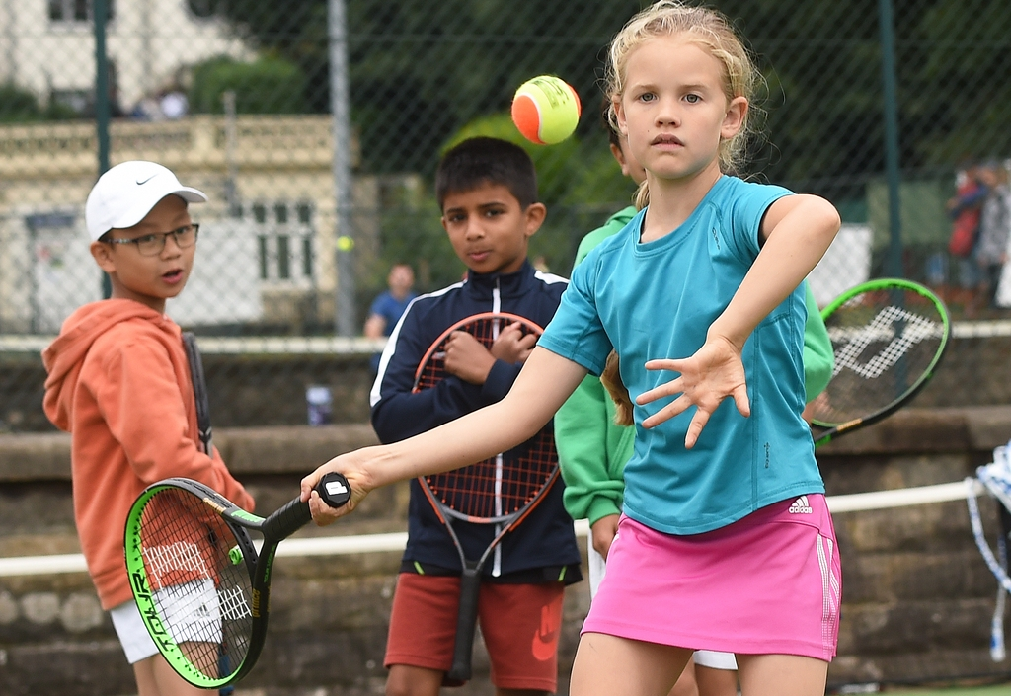
CHARACTER QUALITIES
MOTIVATION
Motivation means doing something because you want to, not because you are told to.

Slide 11
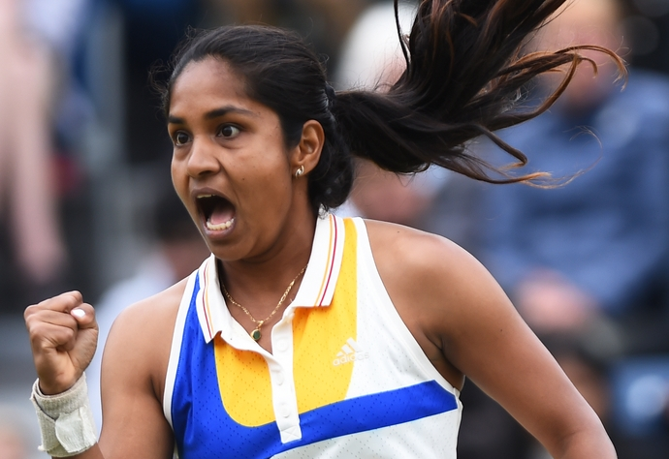
CHARACTER QUALITIES
PASSION
Passion means you have a very strong interest in something – you are excited and enthusiastic about it; you really love it!
The image shows Prarthara Thombare who plays tennis for India. She is currently ranked 327 in the world.
5

Slide 12
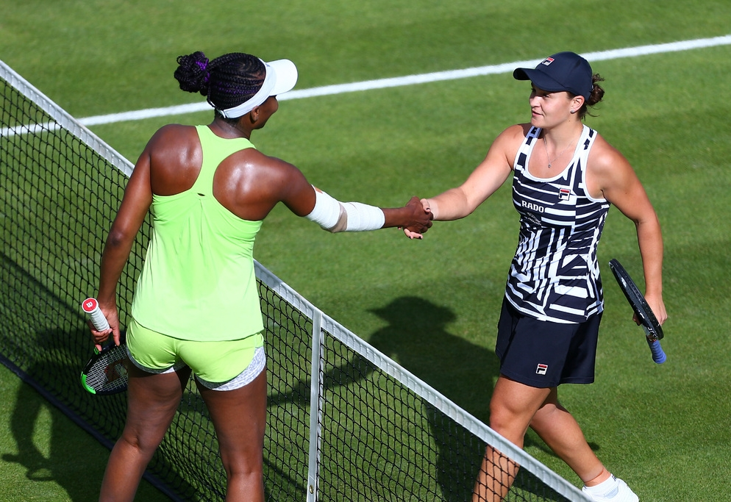
CHARACTER QUALITIES
RESPECT
Respect means thinking about how what you do or say might affect others; listening to others and appreciating who they are and what they do.
The image shows Venus Williams and Ashleigh Barty.

Slide 13
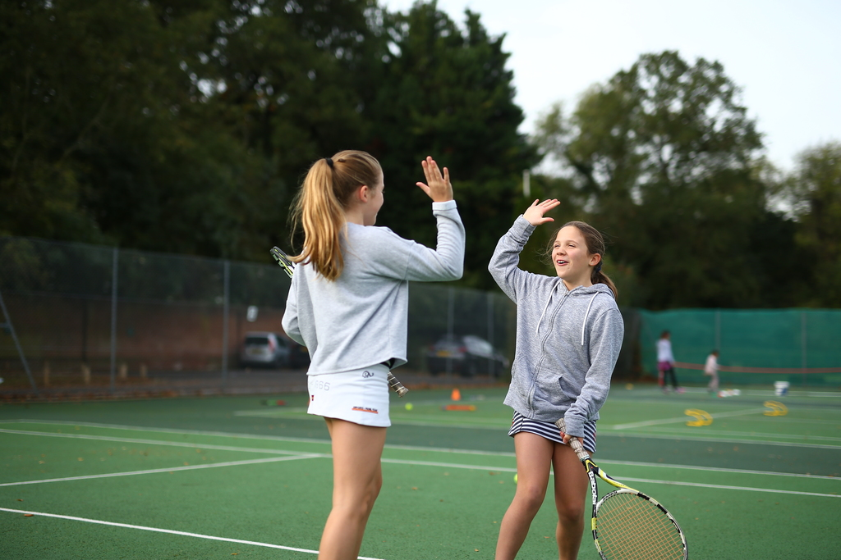
WHAT ABOUT YOU?
Try one of our 5 challenges every day, and see if you can demonstrate these key qualities too!
Motivation
Resilience
Perseverance
Passion
Respect

